Slide 1
CLOUD-BASED MACHINE LEARNING AND SENTIMENT ANALYSIS
by
EMMANUEL CHUKWUYEREM OPARA
(Under the Direction of Hayden Wimmer)
A Thesis Submitted to the College of Graduate Studies at Georgia Southern University
in Partial Fulfillment of the Requirements for the Degree
MASTER OF SCIENCE
INFORMATION TECHNOLOGY
STATESBORO, GEORGIA

Slide 2


Table of Contents
Introduction
Literature review
Methods
Results
Conclusion
References

Slide 3
Introduction
The first research study involved the use of a standard cybersecurity dataset and cloud-based auto-machine learning algorithms were applied to detect vulnerabilities in the network traffic data. The performance of the algorithms was measured and compared using standard evaluation metrics.
The second research study involved the use of text-mining social media, specifically Reddit. We mined up to 100,000 comments in multiple subreddits and tested for hate speech via a custom designed version of the python Vader sentiment analysis package.
In the third research project, we applied statistical techniques in evaluating the significant difference in text analytics, specifically the sentiment-categories for both lexicon-based software and cloud-based tools.

Slide 4
Literature Review(Study 1)
Butt et al. (2020) discussed the Machine learning and Deep learning technique used in presenting analysis for Cloud Computing (CC) threats, attacks, and issues. The authors established that using supervised ANN technique and testing their models using the KDD-CUP and NSL-KDD datasets, they were able to detect security attacks and intrusion by unauthorized users. It has an accuracy of 97% in detecting these attacks. The Supervised SVM classifier which finds information for regression analysis, sorting and decision tree, improves the datasets and provides a 99.7% accuracy in detecting security threats.
Yeung, Wong, Tam, and So (2019) used machine learning in cloud technology to solve the issue faced by e-commerce developers and users on cloud platforms. They proposed an approach to handle the issue of building data analytics on cloud platforms. They used the Amazon Sage-Maker to illustrate how machine learning models are integrated into data analytic processes. The authors try to tackle the business need of better understanding customer behaviors and market trends. The results of this survey show that cloud platforms have been designed and developed for business cases that require more complicated ML algorithms in doing analysis and predictions.

Slide 5
Literature Review(Study 2)
Ruwandika and Weerasinghe (2018) developed a model to detect hate speech using machine learning techniques. The author utilized both supervised and unsupervised machine learning techniques. The techniques used were Logic regression, Navies bayes, Decision tree and K-means. The author compared the results gotten from the algorithms with lexicon-based approaches, and the Navies Bayes classifier performed best with an F-score of 0.719. The dataset used were comments from News articles posted on the Colombo Telegraph website. 1500 preprocessed comment dataset were used.
Machova, Mach, and Vasilko (2021) proposed an offensive language detection system to analyze over 50,000 German hate tweets posted between August 2017 and April 2018. The authors used a combination of qualitative approaches with quantitative techniques from Natural Language Processing (NLP). To evaluate the qualitative approach, they analyzed a random subsample of 2,000 tweets, then compared the results to support quantitative evidence. They computed the average score for all tweets resulting in about 32% of the hate tweets predicted as negative, against 22% of the safe tweets, or a 10% difference. They utilized Character trigrams to efficiently model linguistic variation such as spelling errors, word inflections, function words. In order to evaluate the Perceptron algorithm used, they did a cross evaluation with a hold-out set of the 1,000 most offensive examples in the hate speech dataset

Slide 6
Literature Review(Study 3)
White and Rege (2020) performed sentiment analysis using services on the google cloud platform. The experiment was conducted utilizing two services available on the Google Cloud Platform (GCP) for performing sentiment analysis, which are Natural Language API and Auto-ML Natural Language. The dataset used in this experiment consisted of 1.5 million labeled comments which was retrieved from the Kaggle website. 1,675,189 comments were labeled as positive sentiments, while 104,796 were labeled as negative comments. The authors utilized Natural language API on GCP for sentiment analysis, the authors created a project on google cloud platform, then they enabled the google Natural Language API. The results obtained when using natural language API were represented in a confusion matrix and an ROC Curve. The overall accuracy of the prediction was only 57%. When utilizing Auto-ML natural language, the author labeled the data as “TRAIN”, “VALIDATION”, and “TEST”. The Auto-ML service will automatically train a model using the training and validation data. After the training is complete, the service uses the testing data to determine the true quality of the sentiment analysis and makes various quality metrics available on the GCP console

Slide 7



Study 1: Auto-ML Cybersecurity Data Analysis Using Google, Azure, and IBM Cloud Platforms
Automated machine learning (Auto-ML) increased the creativity and productivity of data scientists because it saves effort on the repetitive tasks in ML training pipeline.
When utilizing the Azure machine learning tools in the machine learning studio, workflows are optimized for better performance on the cloud service.
The machine learning services and tools which are embedded on different platforms are similar in training and deployment of models but differ in the different open-source framework embedded in the them. The training and deployment of models are similar in process but differ in open-source framework.
Some of the frameworks it supports are Py-torch, TensorFlow, Scikit-learn, XGBoost, R, .NET, keras, Ray RLLib, Open Neural Network.
The process of data featurization and algorithm for training which was done in the studio of the Python SDK environment. Hyperparameter optimization is automated, and the results are visualized in the studio.

Slide 8
Dataset utilized in Study 1
For this research study, the UNSW-NB15 dataset was used.
The number of records in the training set is 175,341 records and the testing set is 82,332 records from different types of attacks.
The dataset contains 49 attributes. There were ten different type of attacks namely, Fuzzers, Analysis, Backdoors, DoS, Exploits, Generic, Reconnaissance, Shellcode and Worms.

Slide 9
Data Pre-processing
First, we evaluated the dataset, there were four discrete variables in this dataset which were denoted by the following attributes, Protocol, Service, State, and Attack_category.
The target variable was ‘attack category., while the predictor variables or independent variables were (Protocol, service, and state). We also checked the number of occurrences for each attack in the attack_category.
There was a label attribute/column in the dataset. We used the Boolean mask to generate a Boolean array for the service and protocol attributes. Using the (.loc) function, this returns a series of true and false values for each row in the data frame.
We set the value count for both the service and protocol, that is we set the values for protocol and service to be True when the label = 0, and False when the label = 1

Slide 10
MACHINE LEARNING CLASSIFIER
Now the dataset is ready for analysis. The algorithms which were utilized for predictive modeling in this experiment were Decision Tree Classifier, Random Forest Classifier, and Gradient Boosting Classifier.
When performing Auto-ML on the cloud platform, it is important to clean the dataset and prepare it for the algorithms intended for use on them.
This pre-processed dataset is read into the cloud storage and then, the machine learning needed to train this model is chosen or it can be set to Automatic.

Slide 11
Method for Study 1
Azure Auto-ML
It supports data pre-processing, importing, validating, and cleaning, transformation and normalization. It also performs splitting of the data into testing, training, and validation (cross validation).
To efficiently train and validate the data, the azure ML studio allows you to choose the different hardware compute engine, distributed processor, and progress monitoring all at a pay-as-you-use service
Create The Workspace
Create Compute Instance
Create Compute Clusters
Stop Compute Instances after predictions
Workspace diagnostics

Slide 12
Method for Study 1
Google Auto-ML
The Vertex AI embedded in the google cloud console (GCC) was the service utilized for the machine learning pipelines .
The GCC accepts the uses of CSV or JSONL files and the entity extraction only supports JSON files. It is possible to select use values for the CSV file upload, to choose what aspect of the dataset would be used for training, testing and validation.
Create a Project on the GCC
Enable Billing plan
Enable Vertex API and generate private keys
Install and Initialize the Cloud SDK
Update and install Gcloud components

Slide 13
METHODS
Watson Auto-ML
The process of training data on IBM is quite different. Firstly, the studio allows the users load both data gotten from a single source and data gotten from multiple sources. This is only if the multiple files all have a common key assigned to them. It accepts CSV files,
Additional users within organizations to the IBM cloud account
Sign up for IBM Cloud account for Data as a service on Cloud Pak
Setup IBM cloud object storage for use with Cloud Pak
Setup the Watson Machine Learning studio with AI tools
Prepare the Data Fabric (i.e Hyperparameter Optimization Features)

Slide 14
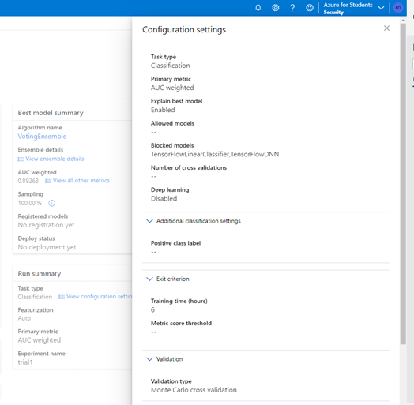
Azure Auto-ML Results
Configuration Setting and Training of dataset in the Auto-ML Environment.

Slide 15
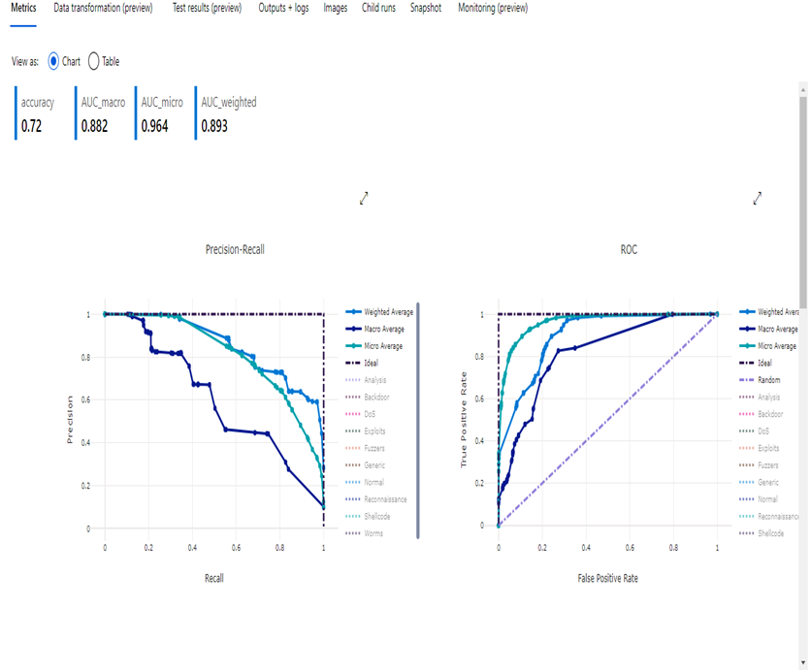
Evaluation Metrics
Completed experiment and Training represented in a line chart

Slide 16
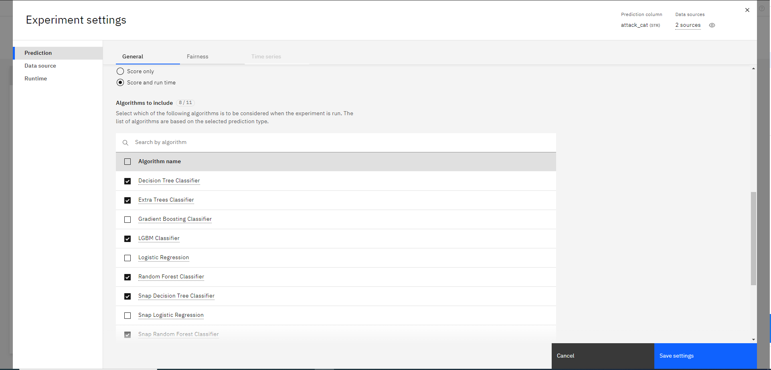
IBM Auto-ML Results

Slide 17
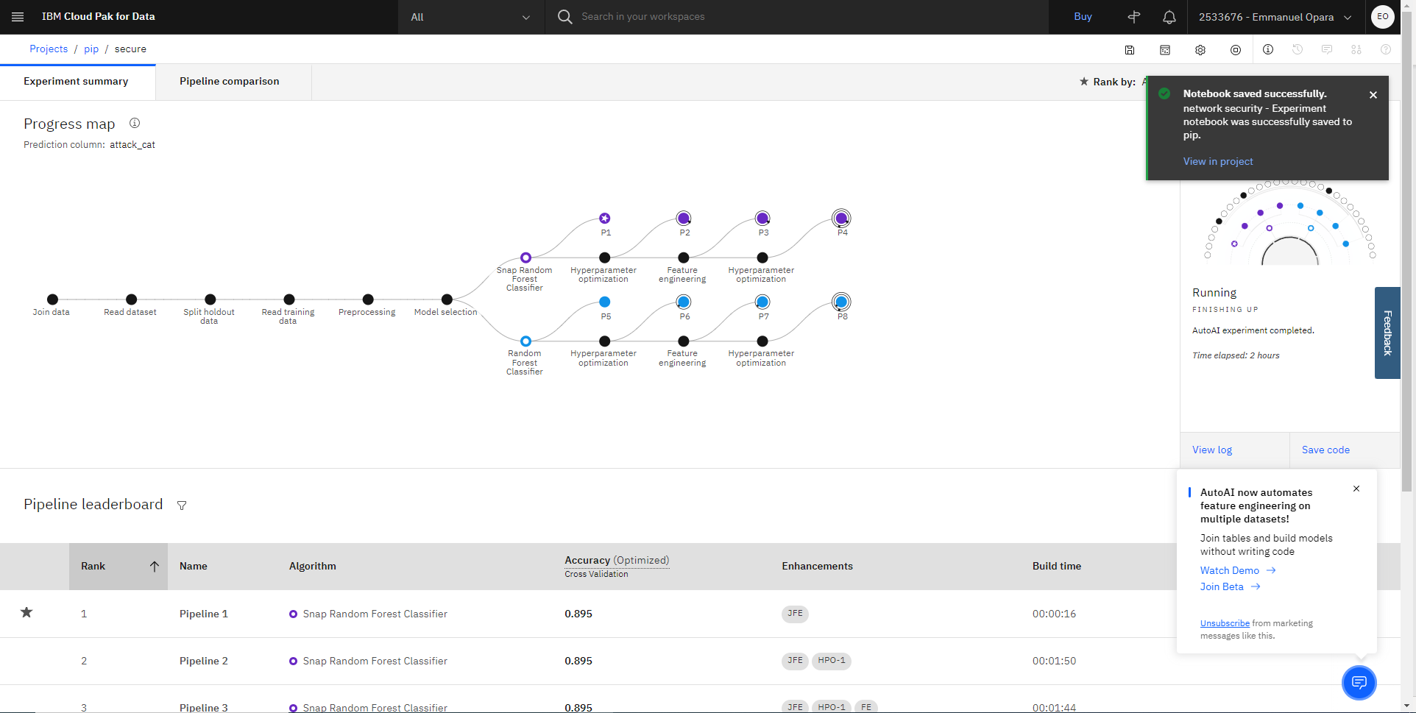
Evaluation metrics
Completed experiment and Training Pipeline

Slide 18
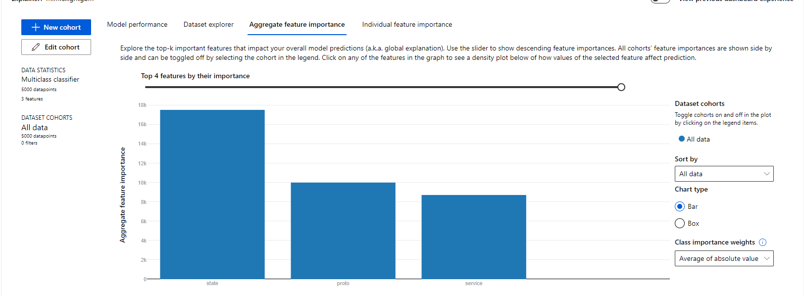
Google Auto-ML Results
Feature importance of the dependent variables

Slide 19
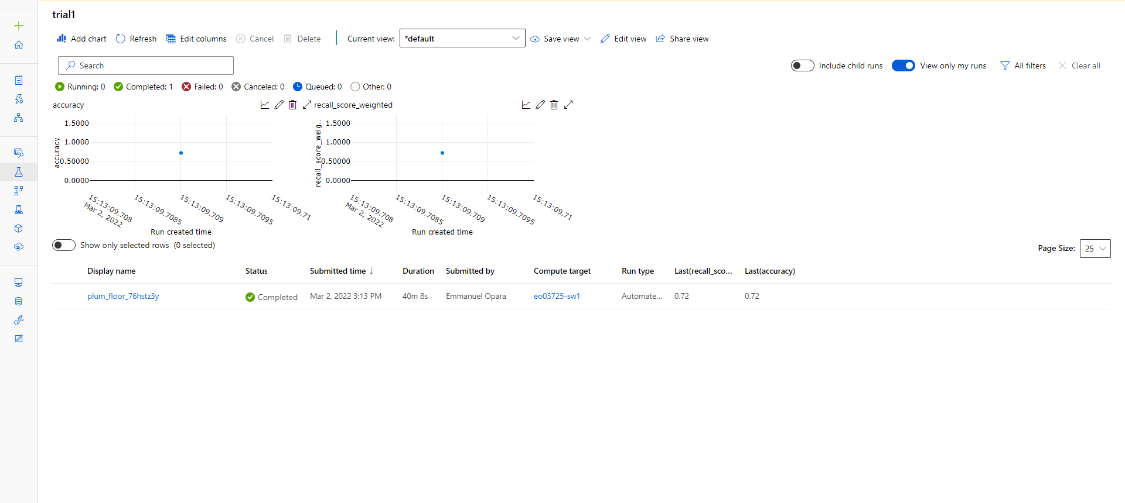
Evaluation metrics
Completed experiment and Line graph showing accuracy level

Slide 20
Auto-ML Results Table
Dataset | Cloud Platform | Algorithm | Accuracy | F1-score
UNSW_NB15 Network security dataset | Azure Cloud Platform | Decision Tree Classifier | 0.725 | 0.892
UNSW_NB15 Network security dataset | Google Cloud Console | Random Forest Classifier | 0.885 | 0.890
UNSW_NB15 Network security dataset | IBM Watson Cloud. | Gradient Boost Classifier | 0.895 | 0.899
Completed experiment and Training Pipeline

Slide 21
Comparative analysis of cloud analysis
 | Google Cloud Platform | Microsoft Azure Cloud | IBM Watson Studio
Auto-ML supported Tools | Py-torch, Tensor-flow, R, RAPIDS, XGBoost, MXNet, CNTK, Google Auto-ML | Py-torch, Tensor-flow, Scikit-learn, XGBoost, LightGBM, Ray RLLib, Keras, Azure Auto-ML | Tensorflow, Scikit-Learn, SPSS, PMML, Hybrid Auto AI, XGBoost, Decision Optimization, Pytorch
Data types allowed | Numerical, Categorical, Datetime, Time-series | Numerical, Categorical, Datetime, Time-series | Numerical, Categorical, Time-series, Image and Text
Model selection and Hyperparameter optimization | Genetic algorithm, Random search, Bayesian Search Neural Architecture | Ensemble, Random search, Bayesian Search. | Genetic algorithm, Random search, Bayesian Search Neural Architecture Ensemble
ML Tasks | Supervised Learning, Unsupervised Learning | Supervised Learning | Supervised Learning, Unsupervised Learning
Model Evaluation/Results analysis visualization | Model dashboard, Feature Importance, Model Summary, | Model dashboard, Feature Importance Model summary | Model dashboard, Feature Importance Model summary Metric comparison
Feature Engineering | Imbalance data, Feature Selection, Advanced feature extraction | Imbalance data, Categorical Processing, Feature Selection, Advanced feature extraction | Imbalance data, Categorical Processing, Feature Selection, Advanced feature extraction
Completed experiment and Training Pipeline

Slide 22


Study 2: Detection of Hate Speech on social media using an Integrated Lexicon-based software
Lexicon-based Software: Vader sentiment is lexicon-based software is based on the lexicon and rule-based methods. It gives the score of a comment in these different categories “negative”, “positive”, “neutral” and “compound”.
The sentiment scores obtained was a normalized score between 1 and -1 which was obtained by adding the valence scores of each category score mentioned above and is adjusted depending on the rules
Integrated Lexicon: Hatebase lexicon was integrated with Vader. We utilized extraction packages in python to make request to the Hatebase API to extract the sentiment and their allocated scores into a textpad. Then we created the integrated lexicon dictionary which we named “VaderHatebase”. This dictionary was separated from the original Vader dictionary which contained its own text words and scores.

Slide 23
Dataset utilized in Study 2
For this research study, We selected the subreddit communities based on a dataset referenced by (Tan & Lee, 2015). This dataset contains posts and comments from the inception of reddit in January 2006 to December 2018. Some subreddits we choose were topic specific (r/Nickelodeon, r/PBSkids, r/Disney, r/4chan).
We collected a corpus of 100k comments from each of the subreddit mentioned above. This data came in large files in csv format.
We utilized the function after and before for extracting historical comment data.
We extracted from the inception year May 2005 to May 2022. The extraction time for each subreddit extraction was about 30minutes.

Slide 24
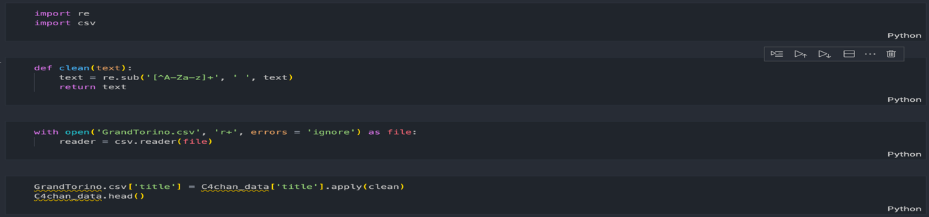
Method for study 2
The data drop function in the panda data frame was applied to the comment data in the csv. The data drop function applied drops the attribute columns not needed for the analysis.
Figure 3: Source code for cleaning comment data

Slide 25
Method for study 2
The scoring mechanism is explained as follows
0.05< Compound score > -0.05 = Neutral Sentiment.
Compound Score ≥ 0.05 = Positive Sentiment
Compound Score ≤ 0.05 = Negative Sentiment
We established evidence that there was an extra level of detection of hate speech when using our integrated lexicon. The null null hypotheses (H0) and corresponding alternative hypotheses (H1) is shown below:
H0: There is a difference between the Vader lexicon dictionary score mechanism and Vader+Hatebase dictionary score mechanism the Vader+hatebase integration will provide a better score
H1: The Vader + hatebase integration is a lower sentiment score

Slide 26
Results for lexicon-based software
Disney comments
4chan comments
 | Vader Scores | VaderHatebase Scores
Sum | 32370.91 | 29867.67
Average | 0.32 | 0.24
 | Vader Scores | VaderHatebase Scores
Sum | -2510.48 | -5430.72
Average | -0.02 | -0.05
Nickelodeon comments
PBSkids comments
 | Vader Scores | VaderHatebase Scores
Sum | 8429.54 | 6553.21
Average | 0.08 | 0.06
 | Vader Scores | VaderHatebase Scores
Sum | 7395.39 | 5581.61
Average | 0.07 | 0.06
Wikipedia ethnic slurs
Gran Torino Comments
 | Vader Scores | VaderHatebase scores
Sum | -3.76 | -6.12
Average | -0.0067 | -0.27
 | Vader Scores | VaderHatebase Score
Sum | -11.13 | -14.35
Average | -0.095 | -0.12

Slide 27
Evaluation Metrics for study 2
4chan Paired Samples Test
 |  | Paired Differences |  |  |  |  | t | df | Sig. (1-tailed)
 |  | Mean | Std. Deviation | Std. Error Mean | 95% Confidence Interval of the Difference
 |  |  |  |  | Lower | Upper
Pair 1 | VaderHatebase - Vader scores | -0.03 | 0.42 | 0.00 | -0.03 | -0.02 | -27.47 | 166770 | 0.000
Wikipedia Ethnic Slurs Paired test
 |  | Paired Differences |  |  |  |  | t-stat | df | Sig. (1-tailed)
 |  | Mean | Variance | Pearson Correlation
 |  |  |  |  | P(T<=t)one-tail | T critical one-tailed
Pair 1 | VaderHatebase - Vader scores | -0.265 | 0.117 | 0.064 | 0.00 | 1.64 | 17.89 | 1116 | 0.000

Slide 28
Evaluation Metrics for study 2
Gran Torino Paired test
 |  | Paired Differences |  |  |  |  | t-stat | df | Sig. (1-tailed)
 |  | Mean | Variance | Pearson Correlation
 |  |  |  |  | P(T<=t)one-tail | T critical one-tailed
Pair 1 | VaderHatebase - Vader scores | -0.03 | 0.02 | 0.94 | 0.01 | 1.65 | 2.21 | 116 | 0.01

Slide 29



Study 3 – Sentiment Analysis using Cloud-based tools and Lexicon-based Software
Machine learning techniques on cloud platforms offer contemporary artificial intelligence services for sentiment analysis, with custom models and identified patterns to give accurate predictions
To achieve the objective of this study, we utilize the Natural language processing in Google cloud platform (GCP), Text Analytics in Microsoft Azure cloud and amazon comprehend
We investigated the scoring mechanism of various cloud analysis services (microsoft azure, amazon, and google cloud platform) and the leading lexicon-based software called vader sentiment analysis. The analysis method for each of these services and software were discussed in detail in this study.

Slide 30
Dataset Utilized in study 3
In this study, we investigated a comment dataset based on the quotes from the movie called “Gran Torino” The dataset contained 200 movie reviews in the format of text. These comments contained both negative and positive sentences. Some of the comments were duplicated and contained stop words and punctuation marks as well as removing URLs and emails. Similar data collection procedure was followed by (Dave, Lawrence, & Pennock, 2003).
After obtaining the data, we perform data cleaning. The data drop function in python was applied to the comment data in the comma-separated value (csv)file. The data drop function applied drops the features in columns not needed for the analysis. The comments dropped down to 85 unique comments, a lot of duplicates were discovered in the dataset. The figure 1 below shows a snippet of the code used for data cleaning.

Slide 31
Method for Amazon comprehend
This service uses natural language processing to extract sentiment about a text. That is, this service analyzed each sentence in the column as a document and returned a score.
Sentiment analysis returns the scores in the following categories:
Positive – The text expresses an overall positive sentiment.
Negative – The text expresses an overall negative sentiment.
Mixed – The text expresses both positive and negative sentiments.
Neutral – The text does not express either positive or negative sentiments.
Each category returns a normalized score between the range of 0 to 1, but it returns in percentage and the sum of all category sum up to 100%.

Slide 32
Method for Azure Text Analytics
In Microsoft Azure cloud platform, the natural language processing service responsible for sentiment analysis is called Cognitive service.
The sentiment analysis feature scores the sentences and returns sentiment labels such as "negative", "neutral" and "positive" based on the highest confidence score found in the sentence.
This feature also returns scores between 0 and 1 for each document-level & sentences within it for positive, neutral and negative sentiment. Created a password key and an endpoint URL which was utilized to authenticate the API requests. Using the Spark table, we exported the data into a csv and stored it in the Azure Synapse storage

Slide 33
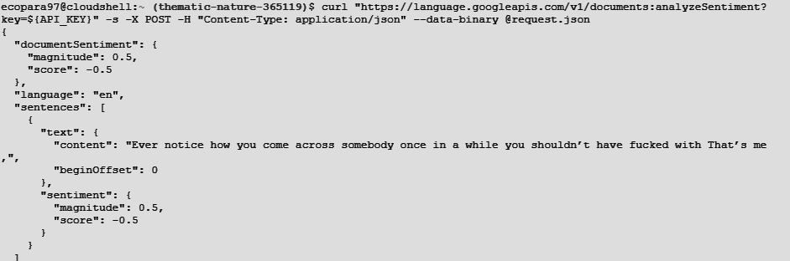
Method for Google Natural language processing
The python environment was created using the application credentials, which involved a client key and an endpoint URL which enables requests from the TextAnalytics API.
To evaluate each content of text in the comma-separated value(csv) file, we converted the csv into a text document and included directly in the JSON request in the editor terminal.

Slide 34

Data Normalization

Slide 35

Data Normalization

Slide 36
Data Normalization
Finally, to compare the scoring mechanism of lexicon-based software with the different cloud service providers, we performed an Analysis of Variance (ANOVA) test.
This analysis was conducted using SPSS. This is a tool used for descriptive analysis.
F-ratio = MST/MSE
MSR = Regression mean square (MSR = SSR/df)
MSE = Error mean square(MSE =SSE/df)
SSR = regression sum of squares
SSE = error sum of squares
df = degree of freedom
SST = Total Sum of squares (SST = SSE + SSR)
MST = Total regression mean square (SST/(P-1))
p=p-value

Slide 37
Results
H₀: There is no significant difference between the negative sentiment category for Amazon comprehend and that of Vader. H₁: There is a significant difference between the negative sentiment category for Amazon comprehend and that of Vader. | H₀: There is no significant difference between the neutral sentiment category for Amazon comprehend and that of Vader. H₁: There is a significant difference between the neutral sentiment category for Amazon comprehend and that of Vader
t-Test: Paired Two Sample for Means
 | AWSNegPct | VaderNegPct
Mean | 0.183 | 0.289
Variance | 0.002 | 0.098
Observations | 83.000 | 83.000
Pearson Correlation | -0.427
Hypothesized Mean Difference | 0.000
df | 82.000
t Stat | -2.852
P(T<=t) two-tail | 0.005
t Critical two-tail | 1.989
t-Test: Paired Two Sample for Means
 | AWSNegPct | VaderNegPct
Mean | 0.183 | 0.289
Variance | 0.002 | 0.098
Observations | 83.000 | 83.000
Pearson Correlation | -0.427
Hypothesized Mean Difference | 0.000
df | 82.000
t Stat | -2.852
P(T<=t) two-tail | 0.005
t Critical two-tail | 1.989
Table 6-1:T-test for negative percentage Table 6-2:T-test for negative percentage

Slide 38
Results
H₀: There is no significant difference between the positive sentiment category for Amazon comprehend and that of Vader H₁: There is a significant difference between the positive sentiment category for Amazon comprehend and that of Vader. | H₀: There is no significant difference between the compound sentiment category for Amazon comprehend and that of Vader H₁: There is a significant difference between the compound sentiment category for Amazon comprehend and that of Vader.
t-Test: Paired Two Sample for Means
 | AWSPosPct | VaderPosPct
Mean | 0.233 | 0.059
Variance | 0.002 | 0.019
Observations | 83.000 | 83.000
Pearson Correlation | -0.106
Hypothesized Mean Difference | 0.000
df | 82.000
t Stat | 10.614
P(T<=t) two-tail | 0.000
t Critical two-tail | 1.989
t-Test: Paired Two Sample for Means
 | AWSCompPct | VaderCompPct
Mean | 0.184 | 0.005
Variance | 0.003 | 0.000
Observations | 83.000 | 83.000
Pearson Correlation | 0.020
Hypothesized Mean Difference | 0.000
df | 82.000
t Stat | 31.894
P(T<=t) two-tail | 0.000
t Critical two-tail | 1.989
Table 6-3: T-test for positive percentage. Table 6-4:T-test for compound percentage.

Slide 39
Results
Descriptive Analysis
Compound score
 | No. of comments | Mean | Std. Deviation | Std. Error | 95% Confidence Interval for Mean |  | Minimum | Maximum
 |  |  |  |  | Lower Bound | Upper Bound
(Amazon Comprehend) | 85 | 0.0050 | 0.0102 | 0.0011 | 0.0027 | 0.0072 | 0.0000 | 0.0534
(Vader) | 85 | 0.1854 | 0.0505 | 0.0055 | 0.1745 | 0.1963 | 0.0317 | 0.2622
(Google NLP) | 85 | 0.4053 | 0.2062 | 0.0224 | 0.3608 | 0.4498 | 0.0500 | 0.9500
(Azure Text-Analytics) | 85 | 0.6288 | 0.2015 | 0.0219 | 0.5854 | 0.6723 | 0.0732 | 0.9078
Total | 338 | 0.3079 | 0.2759 | 0.0150 | 0.2784 | 0.3374 | 0.0000 | 0.9500

Slide 40
Results
ANOVA
Compound score
 | Sum of Squares | df | Mean Square | F | Sig.
Between Groups | 18.452 | 3 | 6.151 | 285.237 | 0.000
Total | 25.654 | 337
Table 6-6: Analysis of Variance test between the cloud platforms and lexicon-based software

Slide 41
Conclusion
In this thesis, a large corpus of data was extracted from social media and sentiments were derived from these comments. Data mining techniques and algorithms for classification were utilized.
A prediction model was developed that enabled us detect vulnerabilities in the network. The use of a cybersecurity dataset was to understand the necessary attributes needed to predict network vulnerabilities.
We utilized cloud-based analytic tools to perform sentiment analysis. A detailed explanation of cloud-based process and the effective use of machine learning algorithms was emphasised in this research. This thesis also gives a sequential procedure on how to utilize machine learning algorithms in other programming languages such as python.

Slide 42
References
Opara, E., Wimmer, H., & Rebman, C. M. (2022). Auto-ML Cyber Security Data Analysis Using Google, Azure and IBM Cloud Platforms. Paper presented at the 2022 International Conference on Electrical, Computer and Energy Technologies (ICECET).
Keijsers, M., Bartneck, C., & Kazmi, H. S. (2019). Cloud-based sentiment analysis for interactive agents. Paper presented at the Proceedings of the 7th International Conference on Human-Agent Interaction.
Graumas, L., David, R., & Caselli, T. (2019). Twitter-based polarised embeddings for abusive language detection. Paper presented at the 2019 8th International Conference on Affective Computing and Intelligent Interaction Workshops and Demos (ACIIW).
Carvalho, A., & Xu, J. (2021). Studies on the Accuracy of Ensembles of Cloud-Based Technologies for Sentiment Analysis. Paper presented at the AMCIS.
Aggarwal, A., Gola, B., & Sankla, T. (2021, 2021//). Data Mining and Analysis of Reddit User Data. Paper presented at the Cybernetics, Cognition and Machine Learning Applications, Singapore.

